Slide 1
WELCOME

Slide 2
CHATBOT PERFORMANCE
-KAMIREDDY MAHENDRA

Slide 3
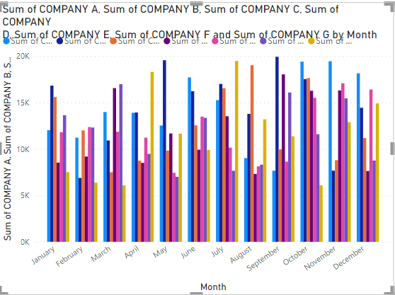
CHATBOT USERS SUMMARY
Company B has the maximum total chatbot users across all remaining companies during the entire time period.
Company B has highest chatbot users per month in the temSepber-2022.
Company B only has the minimum chatbot users per month in Feb-2023.
Company B has the highest average chatbot users across all companies.

Slide 4
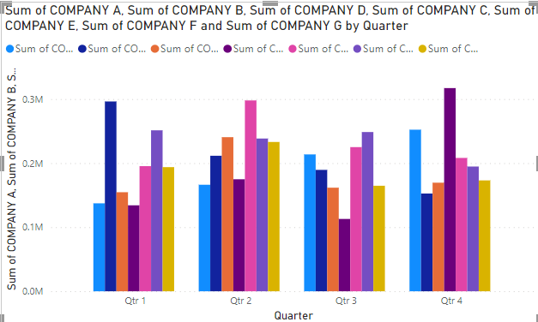
CHATBOT QUERIES SUMMARY
Company D has the highest total chatbot queries across all companies during whole time period.
Company G has the maximum chatbot queries per month among all companies during Feb-2023.
Company G has the minimum chatbot queries per month among all companies during Feb-2023.
Company D has the highest Average chatbot queries during entire time period among all companies.

Slide 5
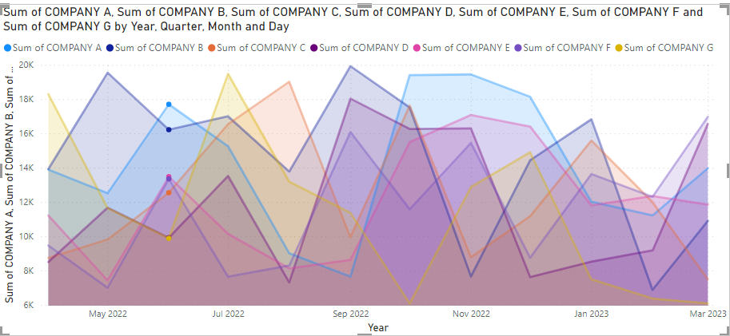
CHATBOT LEADS SUMMARY
Company A has the highest chatbot leads among all companies during whole time period.
Company E has the maximum chatbot leads per month during September-2022.
Company C has the minimum chatbot leads per month during Feb-2023.
Company A has the highest Average Chatbot leads during entire time period.

Slide 6
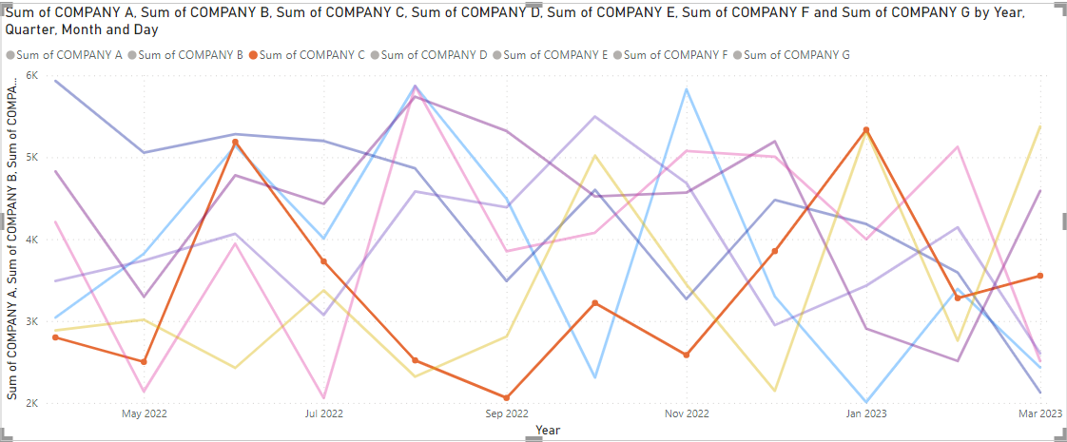
WEBSITE LEADS SUMMARY OF VARIOUS COMPANIES
Company D has the highest total website leads among all companies during entire time period.
Company B has the maximum website leads per month across all companies during April-2022.
Company A has the minimum website leads per month across all companies during Jan-2023.
Company D has the Highest Average website leads across all companies during whole time period.

Slide 7
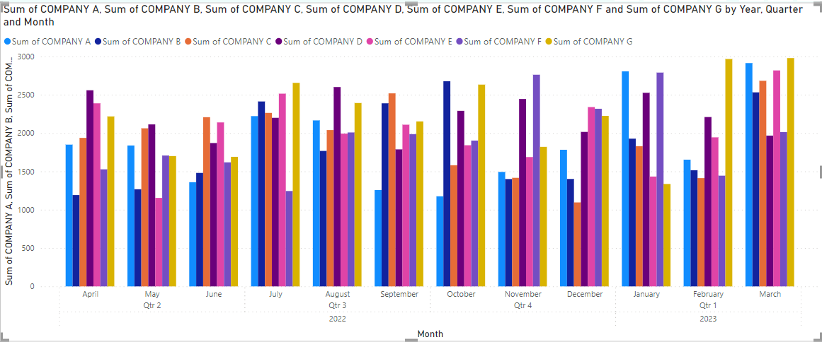
CHATBOT BROCHURE DOWNLOADS SUMMARY
Company G has the highest chatbot brochure downloads among all companies during entire time period.
Company G has the maximum chatbot brochure downloads per month during Mar-2023.
Company C has the minimum chatbot brochure downloads per month during Mar-2023.
Company G has the Highest Average chatbot brochure downloads among all companies during entire time period.

Slide 8
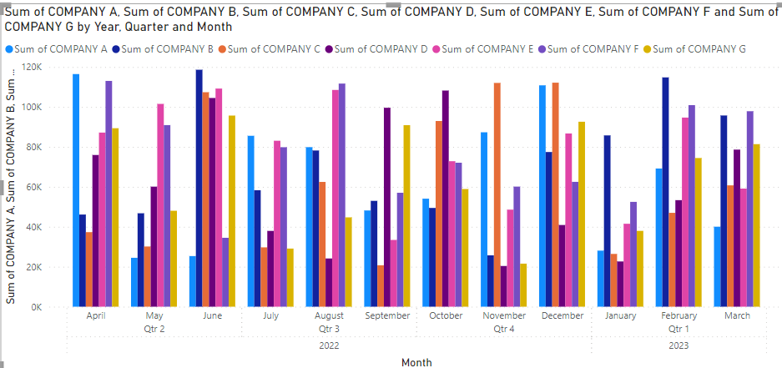
WEBSITE USERS SUMMARY
Company F has the highest total website users among all companies during entire time period.
Company B has the maximum website users per month among all companies during June-2022.
Company D has the minimum website users per month among all companies during Nov-2022.
Company F has the Highest Average website users among all companies during entire time period.

Slide 9
THANK YOU

